Slide 1


UNIVERSITY INSTITUTE OF ENGINEERING
COMPUTER SCIENCE & ENGINEERING
Introduction to Information Security
(Subject Code:20CST-354/ITT-354)
Prepared By : Er. Puneet kaur(E6913)
INTRODUCTION
DISCOVER . LEARN . EMPOWER

Slide 2
Lecture -2.2
(Public Key Cryptography)

Slide 3
Principles of Public Key Cryptosystem
Public-key cryptography evolved from two of the most difficult problems associated with symmetric encryption.
Key distribution under symmetric encryption requires
either that two communicants already share a key, which somehow has been distributed to them
Or the use of a key distribution center (KDC).
Key secrecy is a major concern
Need of Digital signatures

Slide 4
Public Key Cryptosystem
Also known as Asymmetric Encryption.
Public key algorithms rely on one key for encryption and a different but related key for decryption.
These algorithms have the following important characteristic.
It is computationally infeasible to determine the decryption key given only knowledge of the cryptographic algorithm and the encryption key.
Either of the two related keys can be used for encryption, with the other used for decryption.

Slide 5
Terminology Terminology
Plaintext : Original message
Ciphertext : Coded message
Encryption / Enciphering : Process of converting from plaintext to ciphertext
Decryption / Deciphering : Restoring the plaintext from ciphertext

Slide 6
Public Key Cryptosystems Public Key Cryptosystems
Essential Steps
Each user generates a pair of keys to be used for the encryption and decryption of messages.
Each user places one of the two keys in a public register or other accessible file. This is the public key.
The companion key is kept private. This is Private Key.
Each user maintains a collection of public keys obtained from others.

Slide 7
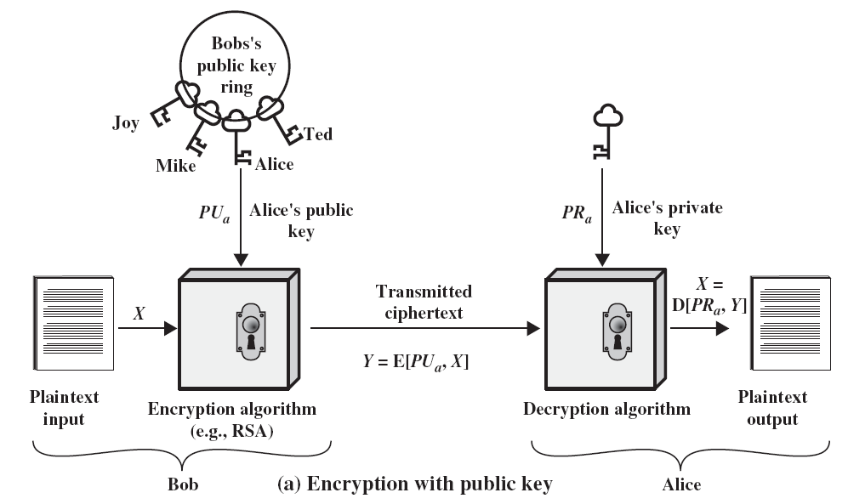
Public Key Cryptosystem

Slide 8
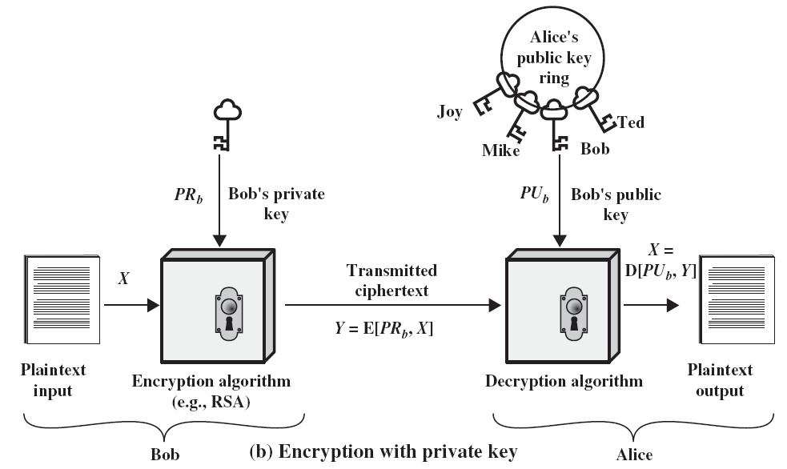
Public Key Cryptosystem

Slide 9
Public Key Cryptosystems Public Key Cryptosystems
With this approach, all participants have access to public keys
Private keys are generated locally by each participant and therefore need never be distributed.
As long as a user’s private key remains protected and secret, incoming communication is secure.
At any time, a system can change its private key and publish the companion public key to replace its old public key.

Slide 10
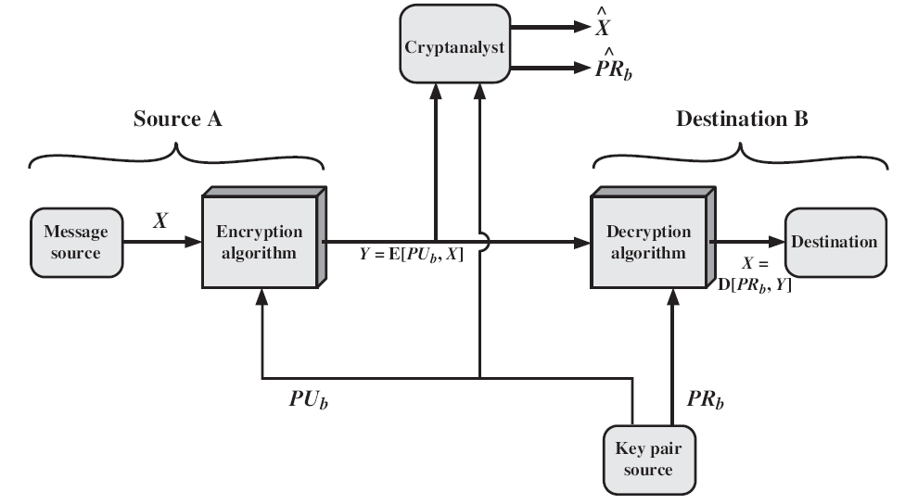
Essential Elements of Public Key Systems

Slide 11
Essential Elements of Public Key Systems
Source A produces a message in plaintext X = [X1, X2,…XM]
The M elements of X are letters in some finite alphabet.
B generates a related pair of keys: a public key, PUb, and a private key, PRb.
PRb is known only to B, whereas PUb is publicly available and therefore accessible by A.

Slide 12


Essential Elements of Public Key Systems
With the message X and the encryption key PUb as input, A forms the ciphertext Y = [Y1, Y2,…YM]
The intended receiver, in possession of the matching private key, is able to invert the transformation:

Slide 13

Essential Elements of Public Key Systems
We know that either of the two related keys can be used for encryption, with the other being used for decryption.
This enables a rather different cryptographic scheme to be implemented for providing authentication.

Slide 14
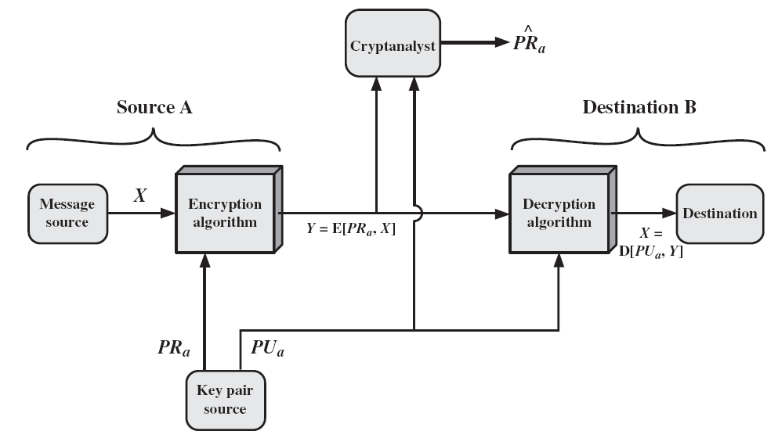
Essential Elements of Public Key Systems

Slide 15
Essential Elements of Public Key Systems
In this case, the entire encrypted message serves as a digital signature.
It is impossible to alter the message without access to A’s private key, so the message is authenticated both in terms of source and in terms of data integrity.
This approach does not provide Confidentiality (because any observer can decrypt the message by using the sender’s public key).

Slide 16
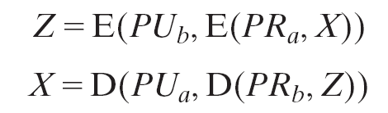
Essential Elements of Public Key Systems
It is, however, possible to provide both the authentication function and confidentiality by a double use of the public-key scheme.
Complex in nature. Must be exercised four times rather than two in each communication.

Slide 17
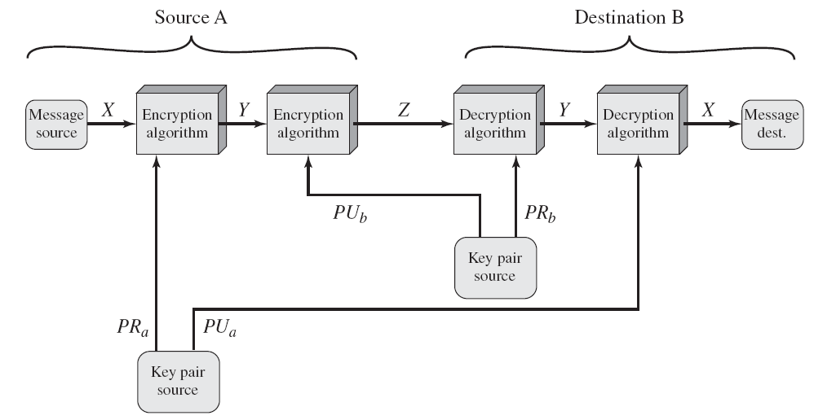
Essential Elements of Public Key Systems

Slide 18
Applications for Public Key Systems
Public-key systems are characterized by the use of a cryptographic algorithm with two keys, one held private and one available publicly.
Depending on the application, the sender uses either the sender’s private key or the receiver’s public key, or both, to perform some type of cryptographic function.
Public-key cryptosystems can be classified into three categories

Slide 19
Applications for Public Key Systems
Encryption /decryption
The sender encrypts a message with the recipient’s public key.
Digital signature
The sender “signs” a message with its private key.
Signing is achieved by a cryptographic algorithm applied to the message or to a small block of data that is a function of the message.

Slide 20
Applications for Public Key Systems
Key Exchange
Two sides cooperate to exchange a session key. Several different approaches are possible, involving the private key(s) of one or both parties

Slide 21
References
http://www.brainkart.com/article/Classical-Encryption-Techniques_8339/
https://www.tutorialspoint.com/cryptography/index.htm
https://www.geeksforgeeks.org/cryptography-introduction/
https://www.techopedia.com/definition/1770/cryptography#:~:text=Cryptography%20involves%20creating%20written%20or,information%20to%20be%20kept%20secret.&text=Information%20security%20uses%20cryptography%20on,transit%20and%20while%20being%20stored.

Slide 22
E- Books Recommended
https://www.pdfdrive.com/cyber-security-books.html
https://bookauthority.org/books/new-cyber-security-ebooks
https://bookauthority.org/books/best-cyber-security-ebooks
https://www.freetechbooks.com/information-security-f52.html

